Slide 1
COMP 3500 Introduction to Operating Systems Project 3 – Synchronization Overview
Adopted from Dr. Xiao Qin’s slides from Fall 2017

Slide 2
Project Objectives
To implement the lock mechanism
To implement condition variables
To solve a synchronization problem using different mechanisms
To improve your source code reading skills
To strengthen your debugging skill
Three weeks to achieve the above objectives!

Slide 3
Three Tasks
Task 1: Code-Reading Assignment (15%)
Task 2: Programming Assignment (70%)
Task 3: Written Assignment (15%)
Notes:
Task 1: Code-Reading Assignment (15%)
Individual;
Task 2: Programming Assignment (70%)
Collaboration
Task 3: Written Assignment (15%)
Discussion

Slide 4
Task 1: Code-Reading Assignment
Time Allocation: < 2 hours
Five Thread Questions (30-40 min)
Three Scheduler Questions (30-40 min)
Two Synchronization Questions (<1 hour)
Use the grep command:
%grep -r “hardclock” .

Slide 5
Task 2: Programming Assignment
Subtask 1: Implementing Locks: 15%
Subtask 2: Implementing Condition Variables (cv): 15%
Subtask 3: A semaphore-based solution in catsem.c: 15%
Subtask 4: A “CV + locks” based solution in catlock.c: 15%

Slide 6
Task 3: Written Assignment
You will have to offer two solutions to the Synchronization Problem: Cats and Mice
(1) Explain how each of your solutions avoid starvation.
(2) Can you derive any principles about the use of these different synchronization primitives (semaphores vs. Condition Variables)?

Slide 7
Tip 1: the kmalloc and kfree functions
int* int_ptr;
int_ptr = kmalloc(sizeof(int));
kfree(int_ptr);
Notes:
Teach students how to take notes.

Slide 8
Tip 2: How to turn interrupts off?
int spl = splhigh();
/*
* Here is a section that must be
* atomically executed
*/
...
splx(spl);
Notes:
Teach students how to take notes.

Slide 9
Semaphore in OS/161 What is the difference?
What we have learned:
typedef struct {
int value; struct process *L; } semaphore;
The semaphore in OS/161:
struct semaphore {
char *name;
volatile int count;
};
Notes:
Teach students how to take notes.

Slide 10
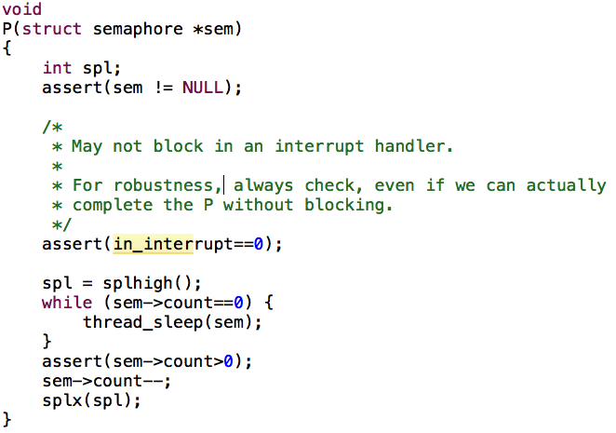
Implement P() using Semaphore in OS/161
Notes:
Teach students how to take notes.

Slide 11
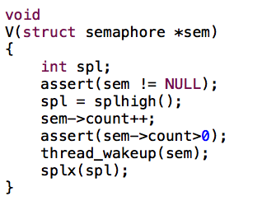
Implement V() using Semaphore in OS/161
Notes:
Teach students how to take notes.

Slide 12
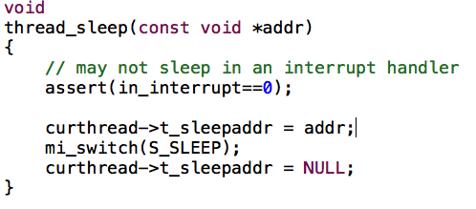
How to P() and V() collaborate through thread_sleep() and thread_wakeup()? See also Question (9) in Section 4.3
Notes:
Teach students how to take notes.

Slide 13
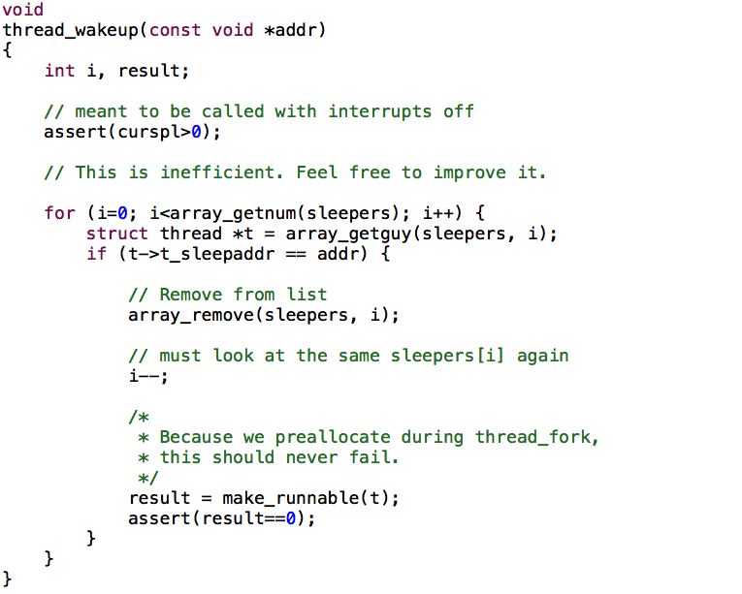
Notes:
Teach students how to take notes.

Slide 14
Locks and Condition Variables (CV) in OS/161
No monitor in OS161
We will use condition variables
We make condition variables independent (i.e., not associated with a monitor)
We will associate CV with a lock (mutex)
Threads must first acquire the lock (mutex)
CV::Wait releases the lock before blocking, acquires it after waking up

Slide 15
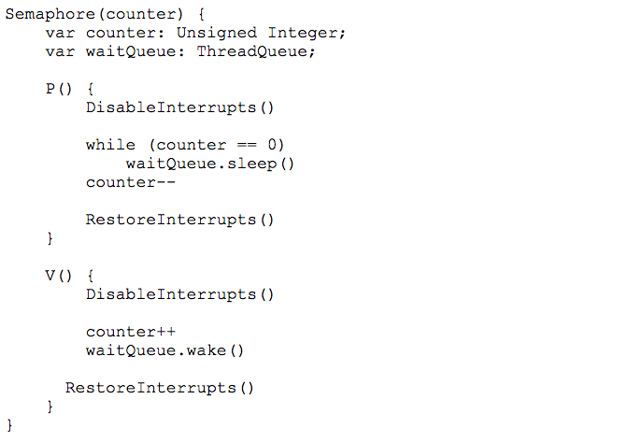
Review 1: Semaphore

Slide 16
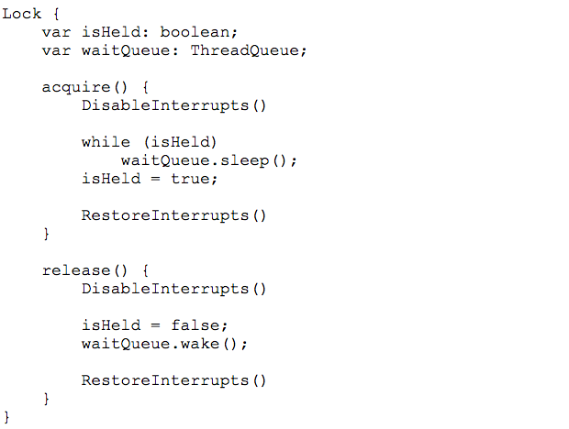
Review 2: Lock

Slide 17
POSIX Mutex-related Functions
int pthread_mutex_init(pthread_mutex_t *restrict mutex, const pthread_mutexattr_t *restrict attr);
int pthread_mutex_destroy(pthread_mutex_t *mutex);
int pthread_mutex_lock(pthread_mutex_t *mutex);
int pthread_mutex_trylock(pthread_mutex_t *mutex);
int pthread_mutex_unlock(pthread_mutex_t *mutex);

Slide 18
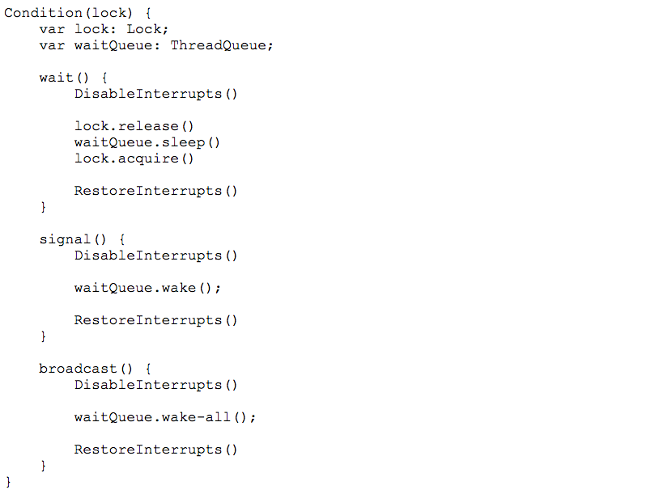
Condition Variable or CV
Notes:
A condition variable is an object used in combination with its associated lock to allow a thread to wait for some condition while it is inside a critical section. Only a thread holding the associated lock is allowed to use a condition variable associated with that lock. A condition variable has only one associated lock, but multiple condition variables may be associated with a single lock.

Slide 19
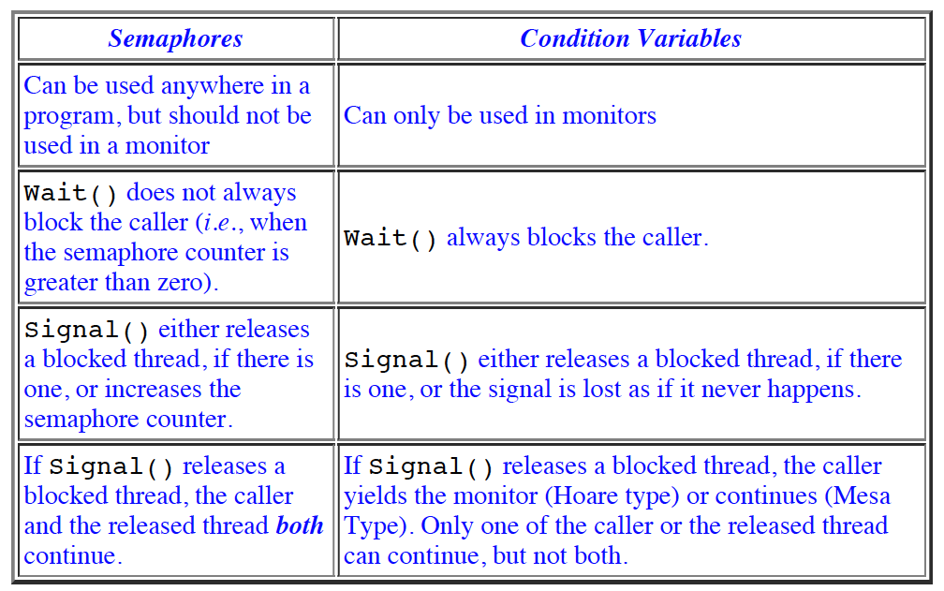
Semaphore vs. Condition Variable
Notes:
Reference:
http://www.cs.mtu.edu/~shene/NSF-3/e-Book/MONITOR/sema-vs-monitor.html
Because the wait and signal operations on semaphores and on condition variables are similar, to help you distinguish their differences and use them correctly, the following is a brief comparison.

Slide 20
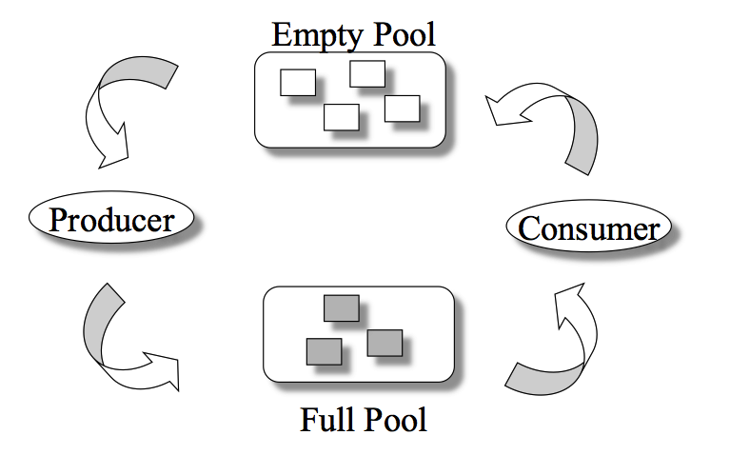
Producer/Consumer Problem
General Statement:
one or more producers are generating data and placing these in a buffer
a single consumer is taking items out of the buffer one at a time
only one producer or consumer may access the buffer at any one time
The Problem:
ensure that the producer can’t add data into full buffer and consumer can’t remove data from an empty buffer
Notes:
We now examine one of the most common problems faced in concurrent processing: the producer/consumer problem. The general statement is this: There are one or more producers generating some type of data (records, characters) and placing these in a buffer. There is a single consumer that is taking items out of the buffer one at a time. The system is to be constrained to prevent the overlap of buffer operations. That is, only one agent (producer or consumer) may access the buffer at any one time. The problem is to make sure that the producer won’t try to add data into the buffer if it’s full and that the consumer won’t try to remove data from an empty buffer. We will look at a number of solutions to this problem to illustrate both the power and the pitfalls of semaphores.

Slide 21
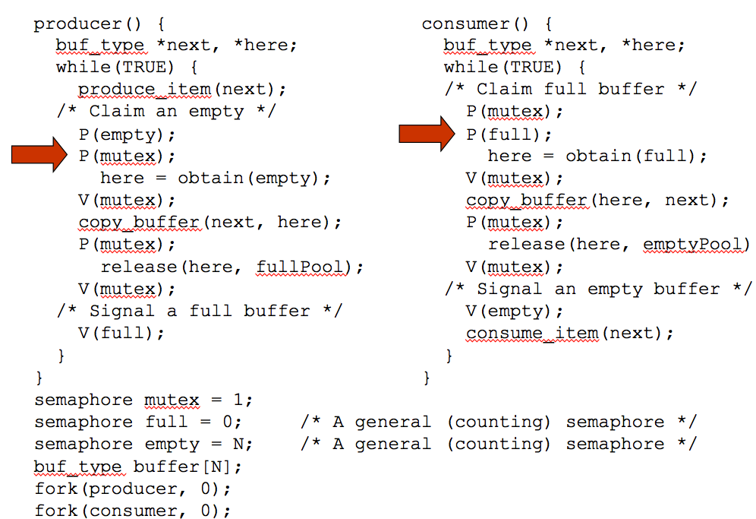
Figure 5.9
An Incorrect
Solution
to the
Infinite-Buffer
Producer/Consumer
Problem Using
Binary Semaphores
Notes:
Let us try to implement this system using binary semaphores. Figure 5.9 is a first attempt. Rather than deal with the indices in and out , we can simply keep track of the number of items in the buffer, using the integer variable n (= in – out ). The semaphore s is used to enforce mutual exclusion; the semaphore delay is used to force the consumer to semWait if the buffer is empty.
This solution seems rather straightforward. The producer is free to add to the buffer at any time. It performs semWaitB(s) before appending and semSignalB(s) afterward to prevent the consumer or any other producer from accessing the buffer during the append operation. Also, while in the critical section, the producer increments the value of n . If n = 1, then the buffer was empty just prior to this append, so the producer performs semSignalB(delay) to alert the consumer of this fact. The consumer begins by waiting for the first item to be produced,
using semWaitB(delay) . It then takes an item and decrements n in its critical section. If the producer is able to stay ahead of the consumer (a common situation), then the consumer will rarely block on the semaphore delay because n will usually be positive. Hence both producer and consumer run smoothly.
There is, however, a flaw in this program. When the consumer has exhausted the buffer, it needs to reset the delay semaphore so that it will be forced to wait until the producer has placed more items in the buffer. This is the purpose of the statement: if n == 0 semWaitB(delay) .

Slide 22
DESIGN

Slide 23
Image Courtesy of toonzone.net
Notes:
Image Courtesy of toonzone.net
http://www.toonzone.net/clip-tom-jerry-show-premieres-april-9-2014-new-sizzle-reel-released/

Slide 24
Synchronizations Among Cats and Mice
Your task is to synchronize the eating habits of cats and mice, such that:
No mouse ever gets eaten, and
Neither the cats or the mice starve.

Slide 25
Exercise 1: Can you use a diagram to illustrate the following specifications?
Two cat food dishes
6 cats and 2 mice
Only 1 mouse or cat may eat at a given dish at any one time
If a cat is eating at either dish, a mouse attempting to eat from the other dish will be seen and therefore eaten
When cats aren't eating, they will not see mice eating.

Slide 26
Understand the Problem
Dish 1
Dish 2
If a cat “eats” dish 1 or dish 2
Then no mice
If a mouse “eats” dish 1 or dish 2
Then no cat

Slide 27
Exercise 2: Please list all possible cases?
Case 1: Dish 1: No Cat/Mouse Dish2: No Cat/Mouse
Case 2:Dish1: Cat i Dish2: No Cat
Case 3: Dish1: Cat i Dish2: Cat j
Case 4: Dish1: Cat i Dish2: Cat j Cat k waits
Case 5: Dish1: Mouse 1 Dish2: No Mouse
Case 6: Dish1: Mouse 1 Dish2: Mouse 2
Case 7: Dish1: Mouse 1 Dish2: Mouse 2 Cat i waits

Slide 28
Exercise 3: What semaphores should you declare?
volatile bool all_dishes_available = true;
semaphore done = 0;
semaphore mutex = 1;
semaphore dish_mutex = 1;
semaphore cats_queue = 0;
volatile int cats_wait_count = 0;
volatile bool no_cat_eat = true; /*first cat*/
semaphore mice_queue = 0;
volatile int mice_wait_count = 0;
volatile bool no_mouse_eat = true;
Notes:
The volatile keyword indicates that a field might be modified by multiple threads that are executing at the same time. Fields that are declared volatile are not subject to compiler optimizations that assume access by a single thread. This ensures that the most up-to-date value is present in the field at all times.
C does not support bool
#define true 1
#define false 0
typedef char bool;

Slide 29
Exercise 4: Complete this algorithm - First Cat and No Mouse
wait(mutex);
If (all_dishes_available) {
all_dishes_availalbe = false;
signal(cats_queue); /* let first cat in */
}
cats_wait_count++;
signal(mutex);
wait(cats_queue); /*first cat in, other wait*/
If (no_cat_eat) {
no_cat_eat = false;
first_cat_eat = true;
}
else first_cat_eat = false;
3
1
2
4
5
6
7

Slide 30
Exercise 5: How does the first cat control the kitchen?
if (first_cat_eat == true) {
wait(mutex);
if (cat_wait_count > 1) {
another_cat_eat = true;
signal(cats_queue); /*let another cat in*/
}
signal(mutex);
}
kprintf(“Cat in the kitchen.\n”); /*cat name */
3
1
2
3

Slide 31
Exercise 6: Complete this algorithm - All cats (first cat and non-first cat) in the kitchen
wait(dish_mutex); /*protect shared variables*/
if (dish1_busy == false) {
dish1_busy = true;
mydish = 1;
}
else {
assert(dish2_busy == false);
dish2_busy = true;
mydish = 2;
}
signal(dish_mutex);
kprint(“Cat eating.\n”); /* cat name */
clocksleep(1); /* enjoys food */
kprint(“Finish eating.\n”); /* done. */
3
1
2
4

Slide 32
IMPLEMENTATION

Slide 33
Review: Semaphores and Variables
volatile bool all_dishes_available = true;
semaphore done = 0;
semaphore mutex = 1;
semaphore dish_mutex = 1;
semaphore cats_queue = 0;
volatile int cats_wait_count = 0;
volatile bool no_cat_eat = true; /*first cat*/
semaphore mice_queue = 0;
volatile int mice_wait_count = 0;
volatile bool no_mouse_eat = true;
Notes:
The volatile keyword indicates that a field might be modified by multiple threads that are executing at the same time. Fields that are declared volatile are not subject to compiler optimizations that assume access by a single thread. This ensures that the most up-to-date value is present in the field at all times.
C does not support bool
#define true 1
#define false 0
typedef char bool;

Slide 34
First Cat and No Mouse
wait(mutex);
if (all_dishes_available == true) {
all_dishes_availalbe = false;
signal(cats_queue); /* let first cat in */
}
cats_wait_count++;
signal(mutex);
wait(cats_queue); /*first cat in, other wait*/
if (no_cat_eat == true) {/*no_cat_eat:global*/
no_cat_eat = false;
first_cat_eat = true;/*first_cat_eat:local*/
}
else first_cat_eat = false;
Notes:
The volatile keyword indicates that a field might be modified by multiple threads that are executing at the same time. Fields that are declared volatile are not subject to compiler optimizations that assume access by a single thread. This ensures that the most up-to-date value is present in the field at all times.
C does not support bool
#define true 1
#define false 0
typedef char bool;

Slide 35
How does the first cat control the kitchen?
if (first_cat_eat == true) {
wait(mutex);
if (cat_wait_count > 1) {
another_cat_eat = true;
signal(cats_queue); /*let another cat in*/
}
signal(mutex);
}
kprintf(“Cat in the kitchen.\n”); /*cat name*/
Notes:
The volatile keyword indicates that a field might be modified by multiple threads that are executing at the same time. Fields that are declared volatile are not subject to compiler optimizations that assume access by a single thread. This ensures that the most up-to-date value is present in the field at all times.
C does not support bool
#define true 1
#define false 0
typedef char bool;

Slide 36
All cats (first cat and non-first cat) in the kitchen.
wait(dish_mutex); /*protect shared variables*/
if (dish1_busy == false) {
dish1_busy = true;
mydish = 1;
}
else {
assert(dish2_busy == false);
dish2_busy = true;
mydish = 2;
}
signal(dish_mutex);
kprint(“Cat eating.\n”); /* cat name */
clocksleep(1); /* enjoys food */
kprint(“Finish eating.\n”); /* done. */
Notes:
The volatile keyword indicates that a field might be modified by multiple threads that are executing at the same time. Fields that are declared volatile are not subject to compiler optimizations that assume access by a single thread. This ensures that the most up-to-date value is present in the field at all times.
C does not support bool
#define true 1
#define false 0
typedef char bool;

Slide 37
All cats (first cat and non-first cat) release dishes.
wait(dish_mutex); /*protect shared variables*/
if (mydish == 1) /* release dish 1 */
dish1_busy = false;
else /* release dish 2 */
dish2_busy = false;
signal(dish_mutex);
wait(mutex); /*protect shared variables*/
cat_wait_count--; /*reduced before leaving*/
signal(mutex);
Notes:
The volatile keyword indicates that a field might be modified by multiple threads that are executing at the same time. Fields that are declared volatile are not subject to compiler optimizations that assume access by a single thread. This ensures that the most up-to-date value is present in the field at all times.
C does not support bool
#define true 1
#define false 0
typedef char bool;

Slide 38
First cat is leaving the kitchen.
if (first_cat_eat == true) { /* first cat */
if (another_cat_eat == true)
wait(done); /* wait for another cat */
kprintf(“First cat is leaving.\n”);
no_cat_eat = true; /*let next cat control*/
/* Switch to mice if any is waiting */
/* (1) Wake up mice */
/* (2) Wake up cat */
/* (3) set all_dishes_available to true */
Notes:
The volatile keyword indicates that a field might be modified by multiple threads that are executing at the same time. Fields that are declared volatile are not subject to compiler optimizations that assume access by a single thread. This ensures that the most up-to-date value is present in the field at all times.
C does not support bool
#define true 1
#define false 0
typedef char bool;

Slide 39
How to wake up waiting mice or cats?
/* Switch to mice if any is waiting */
wait(mutex); /* protect shared variables */
if (mice_wait_count > 0) /* mice waiting */
signal(mice_queue); /* let mice eat */
else if (cats_wait_count > 0)
signal(cats_queue); /* let cat eat */
else all_dishes_availalbe = true;
signal(mutex);
} /* end of first_cat_eat */
else { /* non-first cat is leaving */
kprintf(“Non-first cat is leaving\n”);
signal(done); /* inform the first cat */
}
Notes:
The volatile keyword indicates that a field might be modified by multiple threads that are executing at the same time. Fields that are declared volatile are not subject to compiler optimizations that assume access by a single thread. This ensures that the most up-to-date value is present in the field at all times.
C does not support bool
#define true 1
#define false 0
typedef char bool;

Slide 40
Semaphore in OS/161
/* kern/include/synch.h */
struct semaphore {
char *name;
volatile int count;
};
struct semaphore* sem_create(const char
*name, int initial_count);
void sem_destroy(struct semaphore *);
void P(struct semaphore *);
void V(struct semaphore *);
/* Implemented in kern/thread/synch.c */
Notes:
The Semaphore mechanism has been implemented in OS/161.
Use the source code of semaphore as a good example for the implementation of locks and condition variables.

Slide 41
Semaphore: Sample Usage
/* Declare a semaphore */
static semaphore *sample_sm;
/* Initialize the semaphore */
sample_sm = sem_create(“sample semaphore", 0);
if (sample_sm == NULL) {
panic(”sample_sm: Out of memory.\n");
}
/* Destroy the semaphore in the end */
sem_destroy(sample_sm);
sample_sm = NULL;
P(done); /* Wait for “done” */
V(done); /* Signal “done” */
/* static can limit the scope of global variable to only the file it is declared in */
Notes:
"static" can be used to limit the scope of global variable to only the file it is declared in.

Slide 42
Locks in OS/161
/* kern/include/synch.h */
struct lock {
char *name;
/* add what you need here. How? */
};
struct lock *lock_create(const char *name);
void lock_acquire(struct lock *);
void lock_release(struct lock *);
int lock_do_i_hold(struct lock *);
void lock_destroy(struct lock *);
struct thread *volatile holder;
Notes:
struct lock {
char *name;
// add what you need here
// (don't forget to mark things volatile as needed)
};
Optimization comparison in C[edit]
The following C programs, and accompanying assemblies, demonstrate how the volatile keyword affects the compiler's output. The compiler in this case was GCC.
While observing the assembly code, it is clearly visible that the code generated with volatile objects is more verbose, making it longer so the nature of volatileobjects can be fulfilled. The volatile keyword prevents the compiler from performing optimization on code involving volatile objects, thus ensuring that each volatile variable assignment and read has a corresponding memory access. Without the volatile keyword, the compiler knows a variable does not need to be reread from memory at each use, because there should not be any writes to its memory location from any other thread or process.

